Slide 1

AI Text Summarizer
TRINITY
COLLEGE OF ENGINEERING & TECHNOLOGY
Sai Teja Ankam
H.T. No : 22UD5A7301

Slide 2
AGenda
Introduction
Workflow
Pre-Processing
NLP Types:
Abstract
Extract
Tokenizer
Extractive
Abstractive
Interface
Deployment

Slide 3
Introduction
This project focuses on developing text summarization models using both abstractive and extractive approaches.
It condenses large volumes of information into shorter, readable summaries
Datasets for training
CNN/Daily mails (For extractive)
Xsum (For Abstractive)
Sai Teja Ankam @saiteja

Slide 4
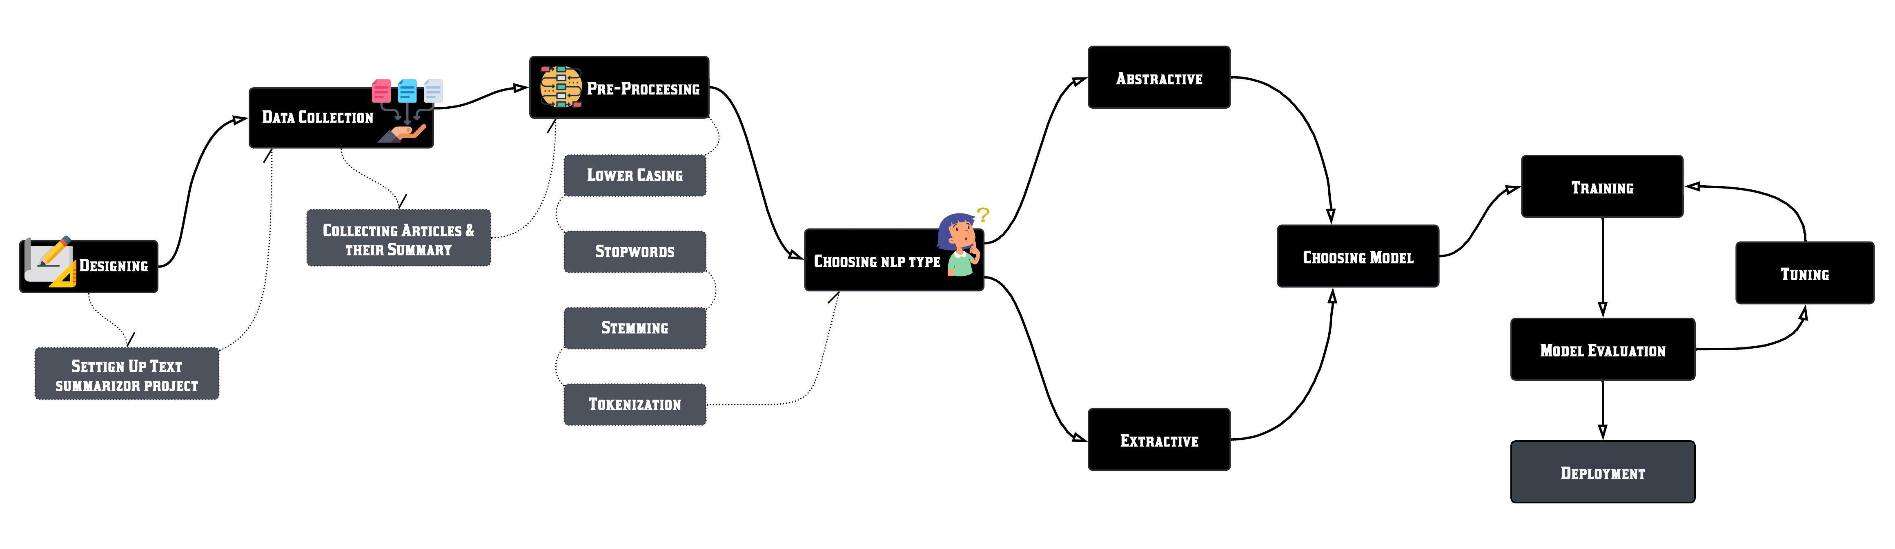
Work Flow
Sai Teja Ankam @saiteja

Slide 5
Data pre-processing
Data Splitting
Initially the datasets has many records, We need to split them as Training examples and Testing records for evaluating the accuracy.
Pre-Processing:
Tokenization
Lower Casing
Stopwords (the,eg.)
Stemming & Lemmatization

Slide 6
Types of summarization
Extractive Summarization
Abstractive Summarization
Extractive summarization involves selecting significant sentences, phrases, or sections directly from the source text and concatenating them to form a summary.
Abstractive Summarization generates new sentences that convey the abstract information from the source text
Let’s go with Extractive summarization first
Sai Teja Ankam @saiteja

Slide 7
Tokenizer
What is Tokenizer??
Tokenizer is a tool that converts our human readable language into tensors (Binary), So it plays most crucial role while dealing with NLP tasks
How to Import ??
To import Tokenizer we need to install Transformers Library in Python.
These Transformers open sourced at HuggingFace webpage which is owned by Google

Slide 8
Extractive summarization
T5-small is known for its efficiency and performance even on smaller hardware setups. T5 (Text-To-Text Transfer Transformer) is a versatile model designed to handle various text-to-text tasks, including summarization.
We Used T5-small model, because it can run on low profile systems
Datasets can be used : CNN/Daily mails
Sai Teja Ankam @saiteja

Slide 9
Rouge-score
Performance

Slide 10
Abstractive summarization
Choosing Model
For the abstractive summarization task, we again used the ‘t5-small’ model, given its suitability and our familiarity with it.
Dataset
XSum Dataset (click to view)
Sai Teja Ankam @saiteja

Slide 11
Rouge
score

Slide 12
After Fine-tuning
After Fine-tuning the model for the first time the Accuracy isn’t efficient
So You can save the finetuned Model and re-train the model on the same dataset
It will improve the Accuracy of the model for sure
Sai Teja Ankam @saiteja

Slide 13
Interface
Integrating Models
Why Django?
Integrated both the models in Django web application
Gave simple user-friendly design for better experience
At my previous internship, I worked as Django developer, so it was easy for me to create robust web applications even with the large models
Sai Teja Ankam @saiteja

Slide 14
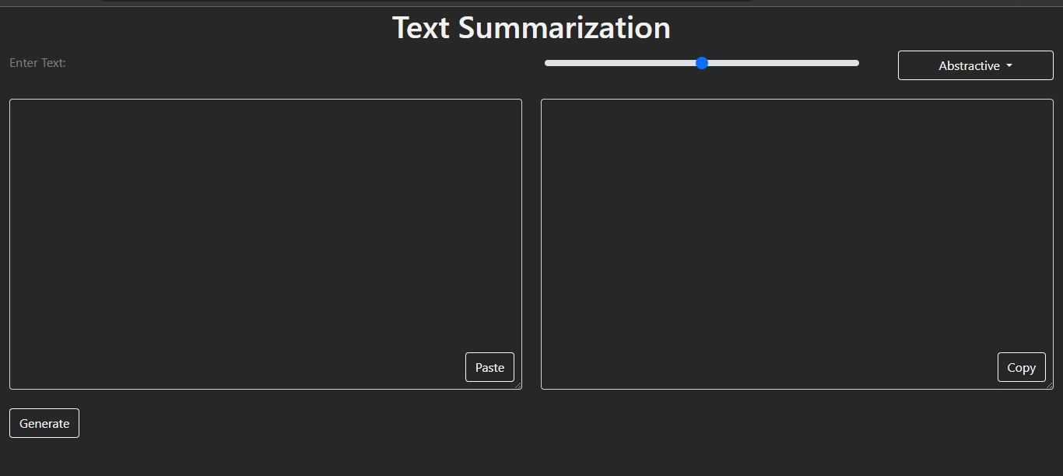
Features
UI Features
Copy paste buttons
Dropdown menu for selecting types of summarization
Range for length of the output
Sai Teja Ankam @saiteja

Slide 15

Deployment
AWS EC2
Deployed the web app in ec2 instance
To access the web app click below link
Text_summarizer
Sai Teja Ankam

Slide 16
Thank You
Sai Teja Ankam @saiteja

